Slide 1

Self-introduction

Slide 2

Brief Introduction
My name is ZhaoXi, or you can call me Jocy.
I am from Xiamen, Fujian Province, China.
Frankly speaking, I really don’t know how to make a interesting self-introduction, and I am a little bit afraid of speaking to strangers, but I’d like to try my best to express myself.

Slide 3
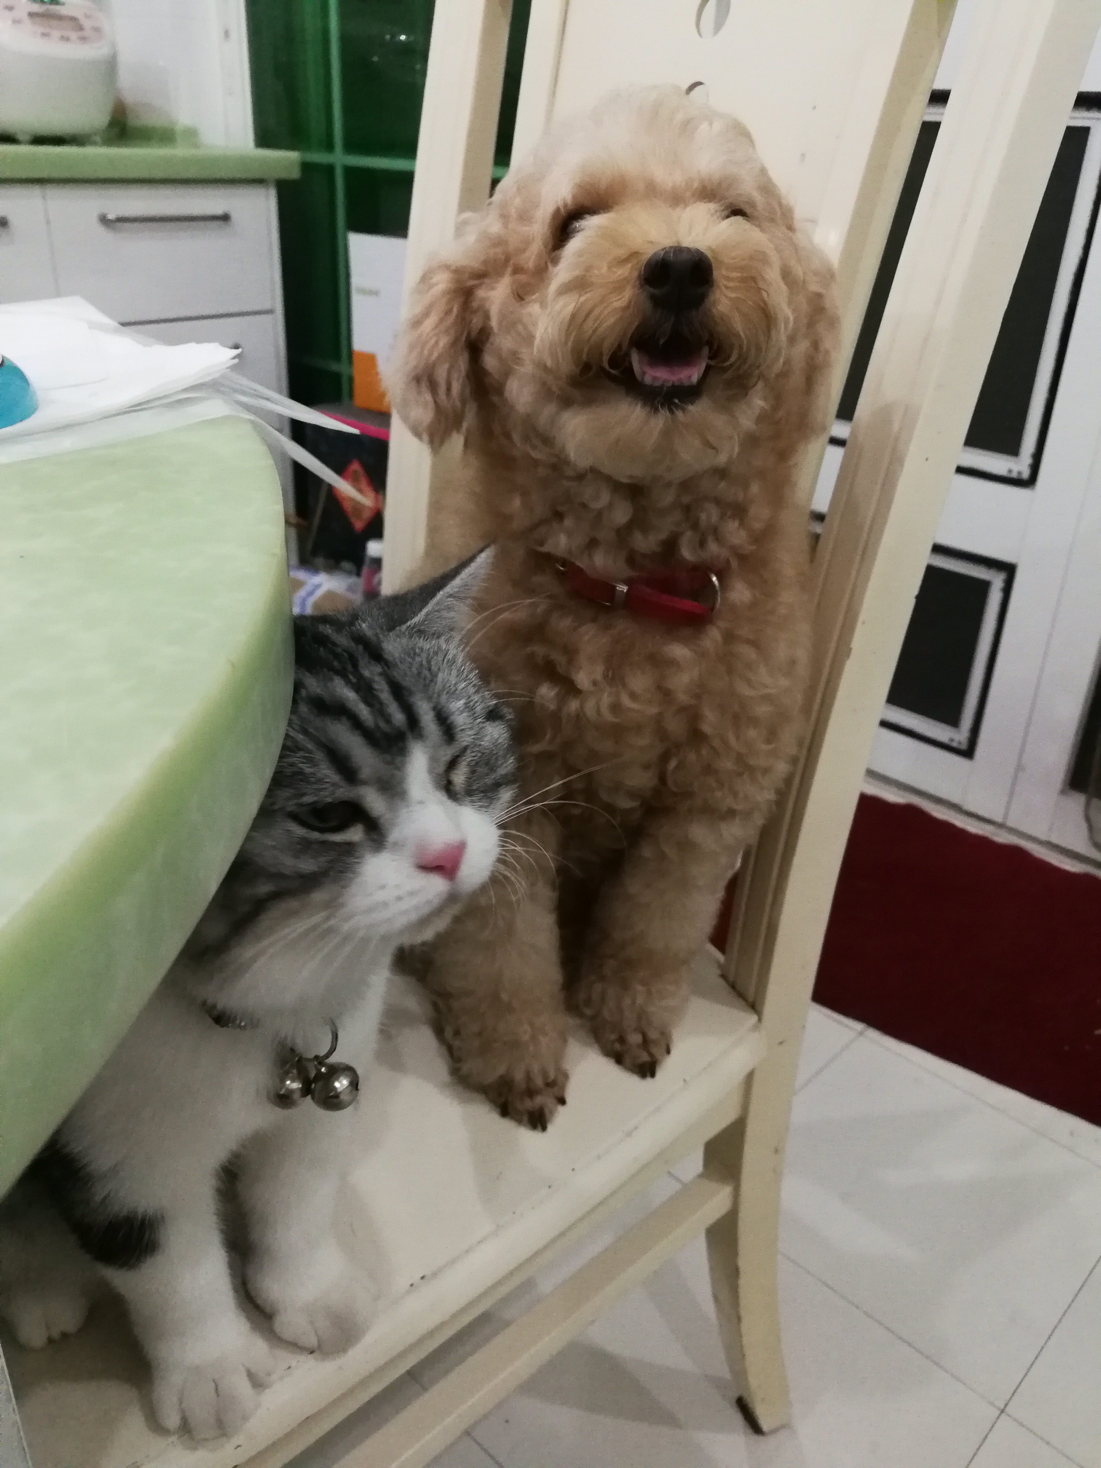

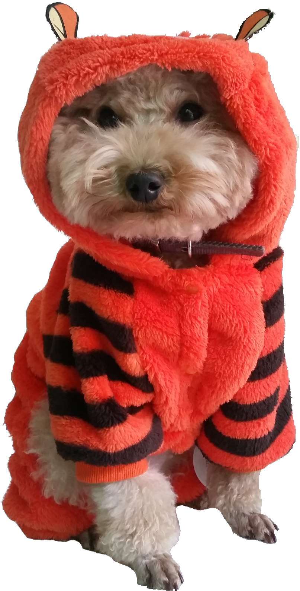

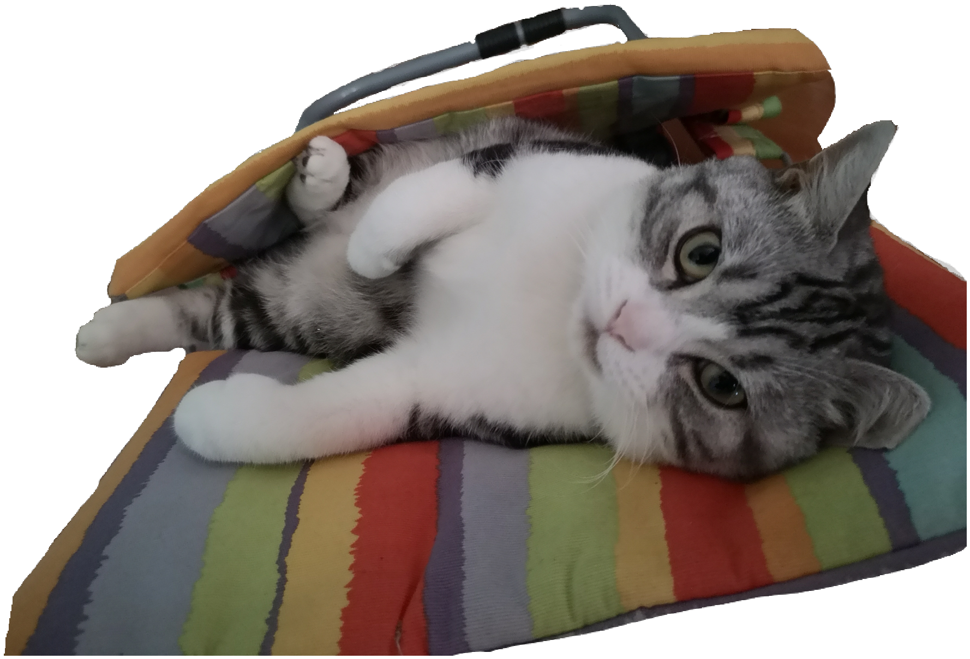
I like drums , and I have played it for several years. That is my
favorite instrument, so that I keep improving my skills.
I can draw some simple paintings.
What’s more, I am good at Teakwondo when I was in primary school.
I think my hobby is really wide, I am interesting in too many things.
My favorite color is green!
I have a dog and a cat in my home, they are sooooo lovely!

Slide 4

FINALLY
This power point is truly boring , lol.
Hope you guys can have a fond memory in XMUM!

